Slide 1
Welcome Parents!
Career Academy of Business Administration & Management
An Academy of Distinction – with Distinguished Honors

Slide 2
CABAM Staff
Kevin Schachter schachterk@pcsb.org | Accounting Applications I; Digital Information Technology, Legal Aspects of Business, Business & Entrepreneurial Principles, Introduction to Hospitality & Tourism, Technology for Hospitality & Tourism, Hospitality & Tourism Marketing Management, Hospitality & Tourism Internship; Business Ed. Directed Study. ***Future Business Leaders of America(FBLA), ***TEDxYouth@PHUHS, ***Technology Coordinator/phuhs.org Webmaster, ***Department Chair
Dzindzi Asamoah-Wade asamoahwaded@pcsb.org | Advanced Information Technology; Foundations of Programming, AP Computer Science Principles, AP Computer Science A, ***National Technical Honor Society, ***Girls Who Code, ***CSR Club
Kay Knox knoxb@pcsb.org | Digital Information Technology; Digital Design I-III; TV Production (Digital Media Technology)
Randy Homa homar@pcsb.org | Personal Financial Literacy; Sports, Recreation & Entertainment Marketing I-III

Slide 3
What is CABAM?
A career academy offering a sequence of courses and programs that provides rigorous and relevant content aligned with challenging academic standards and technical knowledge and essential skills needed to prepare for further education and careers.
CABAM gives students a head start on Life after High School
Academy of Distinction with Distinguished Honors

Slide 4
CABAM Mission
Empowering Success

Slide 5
CABAM Vision Statement
To provide students with rigorous and relevant business concepts and skills, through education and experiences, that are vital for success in life.

Slide 6
CABAM Values
PRIDE³
Professionalism
Results
Integrity
Diversity
Education
Engagement
Excellence

Slide 7
Career Academy of
Business Administration & Management
Text to 81010 for CABAM Reminders
Grade 9: @CABAM28
Grade 10: @CABAM27
Grade 11: @CABAM26
Grade 12:@CABAM25
Like us at facebook.com/cabamphuhs/

Slide 8
What do we do?
Work Based Learning
Job Shadow
Professional Attire
Community Service Project/Bright Futures Hours
Seminars/Business lecture Series
Industry Certifications
Career Preparation
Career & College Fair
Mock Interviews
Resume Help
Field Trips
Incentives
Town Hall
Community Advisory Board
Clubs & Organizations

Slide 9
Work Based Learning

Slide 10
Job Shadow
A short-term work-based educational experience which introduces students to a particular job or career by pairing them with an employee of a business, industry or agency. By following or "shadowing" that employee for a day, students become familiar with the duties associated with that occupation, the physical setting of the occupation, and the compatibility of the occupation with their own career goals.
Wednesday, November 6, 2024

Slide 11
Professional Attire
Professional Dress days allow students to develop an awareness of the image your appearance projects, as well as to learn and practice the finer points of making great first impressions and dressing for success. You will also receive many tips for dressing professionally for special situations like job interviews, business meetings and even business trips.
This is a graded assignment, once per grading period.
Thursday, September 26
Tuesday, November 12

Slide 12
Community Service Project
Designed to: Give students opportunities to earn volunteering hours for Bright Futures; teach Corporate Social Responsibility (CSR); and to foster community in the program and school.
Over the past 10 years CABAM Students have raised over $80,000 and volunteered many thousands of hours for several worthy causes.
Keep Florida Beautiful
FEAST
Suncoast Animal Shelter
PHCC
American Cancer Society – Relay for Life

Slide 13
Seminars & Business Lecture Series
Business Lecture Series
This long running event occurs each semester, where local businesspeople present practical concepts and skills, aimed at helping you prepare for College, Careers, and Life. Past topics have included; Time Management, Math in the Real World, Employer Expectations, Accountability, and Job Interviews.
Seminars
Similar to Lecture Series, but usually shorter and dedicated to a specific Topic.
Dress for Success: Thursday, September 26
Cyber Security Awareness Seminar: October

Slide 14
Industry Certifications
Last year More than 125 CABAM students improved their resumes by earning almost 300 globally recognized credentials with a wide variety of certifications. They also helped boost the school grade, and some earned additional college credits and scholarships and even helped earn money for CABAM (Which we spend on them!)

Slide 15
Career & College Fair/Mock Interviews
This event is an opportunity for you to meet with potential employers, and practice networking, filling out job applications, and even interviewing. Many students receive employment or arrange to complete volunteer hours through these events.
Mock Interviews: Tuesday, October 22
Career Fair: Spring 2025

Slide 16
Community Advisory Board
A group of Business Partners, business owners & managers, entrepreneurs, parents, teachers, and students who assist in adding value to what we are able to offer you, by organizing the programs discussed, offering job shadow opportunities, internships, mentoring and more.
Schedule: (3:00-4:30 p.m.)
Monday, September 9, 2024
Monday, December 9, 2024
January 2025 - TBD
March 2025 - TBD

Slide 17
CABAM Student Advisory Committee
Are you a passionate and driven student interested in shaping the future of our Business Program while earning valuable volunteer community service hours? Here's your chance to make a real impact and pave the way for positive change!
The Student Advisory Committee is a unique opportunity for dedicated students to have a direct say in the development and enhancement of CABAM, including the programs we offer, curriculum we utilize, the activities we participate in, and the causes we get involved in. Your insights, ideas, and feedback will help us create an even more engaging and enriching learning experience for all CABAM students.
See Mr. Schachter with question

Slide 18
Future Business Leaders of America (FBLA)
Future Business Leaders of America is a co-curricular student run organization designed to teach students about business while developing leadership, communication and team skills. All CABAM students are strongly encouraged to participate.
Information on School Website under Clubs & Activities
Next General Meeting: 9/17, 2:10, 11-201

Slide 19
National Technical Honor Society (NTHS)
National Technical Honor Society is a club that recognizes students who have carried an overall 3.0 GPA or higher in their overall academic coursework as well as within their CTE pathway or major. This club has awarded millions in scholarships and comes with a host of other perks for its members. “NTHS membership is the beginning of building a life and career upon a foundation of skill, service, responsibility, citizenship, scholarship, leadership, and honesty”.
Contact either Ms. Asamoah-Wade or Ms. Webb to see if you’re eligible!

Slide 20
Girls Who Code
This be GWC’s fifth year operating at PHUHS. Students create a safe space on campus for aspiring female and female identifying coders and computer scientists to learn together and collectively work towards closing the gender gap in STEM. Members participate in team building exercises, hear from guest speakers who are shaking up the STEM fields and leaders in the CS community, and begin the building blocks of coding.

Slide 21
CSR (Corporate Social Responsibility) Club
This is the first year for CSR (Corporate Social Responsibility) Club. This club was initiated to foster student stewardship beginning with our school community. We will be conducting campus wide clean ups twice each month from 2-3pm. Student can earn 1 bright futures volunteer hour with each clean up. The first general information meeting will be held next Wednesday 8/28 from 2-2:20pm in 11-202 (Ms. Asamoah-Wade’s room). This club is in need of leadership positions. If you are interested in being a leader of this club please express your interest to me before or on 8/28.

Slide 22
TEDxYouth@PHUHS
Student run TEDxYouth Event
Meets alternate Thursdays after school in 11-201
Event Planning & Management
Speaker Curation
Video Production
Next Meeting 9/26

Slide 23
Field Trips:
Amelie Arena 10/21/2024
Florida Restaurant Show
Innisbrook Resort
Hyatt Regency
Nielsen Media
FBLA National Conferences:
2025: Anaheim, CA; 2026: San Antonio, TX; 2027: Nashville, TN; 2028: Columbus, OH
Synapse Summit, Tampa: February 2025?
Senior Trip – Epcot – March 7, 2025
CABAM: “Business in…New York” February 15-18, 2025

Slide 24
Incentives
Grad Cords for Program Completers
T-Shirts
Prizes, Gift Cards/Certificates, Swag
Scholarships (Gold Seal/Bright Futures)
The Tim & Susan Bryce Scholarship $1,000
College Credit (SPC)
Reduced Cost on Field Trips

Slide 25
CABAM Programs
Digital Information Technology
Hospitality & Tourism Management
Digital Design
Digital Design I*
Business Management & Analysis
Digital Design II
Introduction to Hospitality & Tourism
Technology for Hospitality & Tourism
Legal Aspects of Business
Accounting I
Sports, Entertainment & Recreation Marketing
Sports, Entertainment & Recreation Essentials
Sports, Entertainment & Recreation Applications
Sports, Entertainment & Recreation Management
Hospitality & Tourism Management & Marketing
Hospitality & Tourism Internship
Sports, Entertainment & Recreation Internship
Digital Design III
Business & Entrepreneurial Principles
Computer Science
Advanced Information Technology
AP Computer Science Principles
AP Computer Science A
Digital Design IV
TV Production
Digital Media Technology
Digital media Fundamentals
Digital Media Production
Digital media Delivery
Foundations of Programming

Slide 26
CABAM Standalone Courses
Digital Information Technology
Personal Financial Literacy
Business Education Directed Study

Slide 27
Upcoming Opportunities/Events
FBLA: Sept. 17
Professional Dress Day – Thursday, Sept. 26
Chick-fil-A Hiring Event - TBD
Mock Interview Day – Tuesday, Oct. 22
Job Shadow – Wednesday, Nov. 6
Great American Teach In, Wednesday, Nov. 13

Slide 28
Common Career Technical Core Career Ready Practices
Career Ready Practices describe the career-ready skills that students should develop. These practices are not exclusive to a class, Career Pathway, program of study, discipline or level of education. Career Ready Practices should be taught and reinforced in all career exploration and preparation programs with increasingly higher levels of complexity and expectation as a student advances through a program of study.

Slide 29
Common Career Technical Core Career Ready Practices
Act as a responsible and contributing citizen and employee.
Apply appropriate academic and technical skills.
Attend to personal health and financial well-being.
Communicate clearly, effectively and with reason.
Consider the environmental, social and economic impacts of decisions.
Demonstrate creativity and innovation.
Employ valid and reliable research strategies.
Use critical thinking to make sense of and persevere in solving problems.
Model integrity, ethical leadership and effective management.
Plan education and career paths aligned to personal goals.
Use technology to enhance productivity.
Work productively in teams while using cultural/global competence.

Slide 30
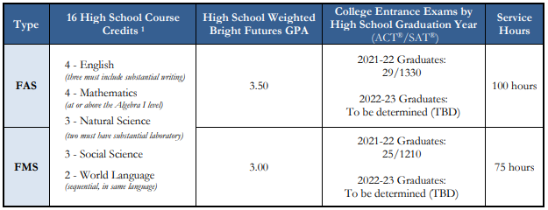
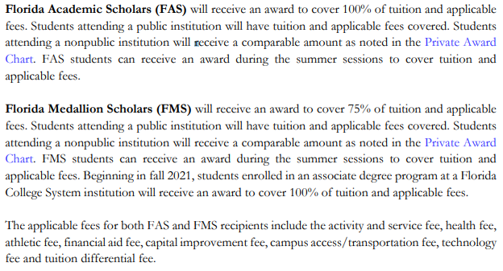
Academic and Medallion Scholarships
Type | High School Course | HS GPA | ACT / SAT Scores | Service Hours | Award
FAS | 4 – English 4 – Mathematics 3 – Natural Science 3 – Social Science 2 – World Language | 3.50 | 2021–22 Graduates: 29 / 1340 2022–23 Graduates: TBD | 100 hours | 100%
FMS |  | 3.00 | 2021–22 Graduates: 25 / 1210 2022–23 Graduates: TBD | 75 hours | 75%
Bright Futures
Source: https://www.floridastudentfinancialaidsg.org/SAPBFMAIN/SAPBFMAIN

Slide 31
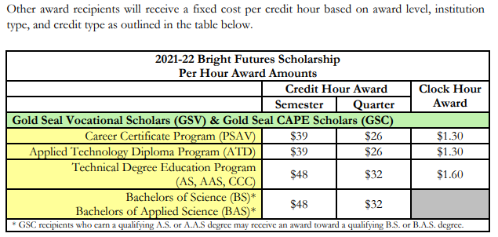
Gold Seal: Vocational (GSV) or CAPE (GSC)
GSV and GSC award recipients will receive a fixed cost per credit hour based on award level, institution type, and credit type as specified in the BF Student Handbook, chapter 2.
Gold Seal awards (GSC/GSV) may only be used at postsecondary institutions that offer an applied technology diploma, technical degree education program (associate in science-A.S. or associate in applied science-A.A.S.), or a career certificate program. GSC recipients who earn a qualifying A.S. or A.A.S. degree may be funded for a qualifying B.S. or B.A.S. bachelor’s degree.
Bright Futures
Notes:
Questions for BF:
Do the CAPE certifications have to be from the same Associate Degree Program? No, they just need the articulated credit.
Does the student have to be enrolled in the Associate Degree program that aligns with their certifications? No
How is this impacted with dual enrollment? No impact if student is enrolled in HS and earns certification.
Can the certifications be earned in middle school? [assuming yes, but confirm with Timberly]

Slide 33
Articulated Certifications (examples)
This list is only a few of the CAPE certifications that have articulated credit.
FDOE Cert. Code | Certification Title | # of Credits Articulated
ADOBE023 | Adobe Certified Professional in Video Design (Requires Premiere Pro and After Effects or Photoshop) | 4
ADOBE024 | Adobe Certified Professional in Visual Design (Requires Photoshop and Illustrator or InDesign) | 3
AIOPB001 | Certified Bookkeeper | 3
PROSO003 | Certified Internet Web (CIW) E-Commerce Specialist | 3
PROSO017 | Certified Internet Web (CIW) JavaScript Specialist | 3
COMPT007 | CompTIA Project+ | 3
COMPT008 | CompTIA Security+ | 3
ICOEC005 | EC-Council Cyber Forensics Associate | 3
ICOEC006 | EC-Council Ethical Hacker Associate | 3
MICRO089 | Microsoft Certified Solutions Expert (MCSE) - Data Platform | 3
MICRO069 | Microsoft Office Specialist (MOS) Bundle Certification (3 of 6) | 3
MICRO017 | Microsoft Office Specialist Master | 3
MICRO080 | Microsoft Technology Associate (MTA) - HTML5 Application Developer Fundamentals | 3
MICRO104 | Microsoft Technology Associate (MTA) - Introduction to Programming Using JavaScript | 3
MICRO112 | Microsoft Technology Associate (MTA) - Introduction to Programming Using Python | 3
INTUT001 | QuickBooks Certified User | 3
UNITY001 | Unity Certified Associate | 6
UNITY002 | Unity Certified User: Programmer | 6
Bright Futures – Gold Seal CAPE
Eligible CAPE Certifications: Active Articulation Agreements Summary www.fldoe.org/core/fileparse.php/7525/urlt/active-articulation-summary.xlsx

Slide 34
Through the articulation agreement with St. Petersburg College, students will earn college credit if specified criteria are met.
For current course articulation and requirements, visit www.spcollege.edu/connect; select Pinellas County High School – Academy College Credit.
Each PCS high school’s CTE program is listed with the applicable SPC articulation.
SPC articulation is subject to change.
SPC Articulation

